Slide 1
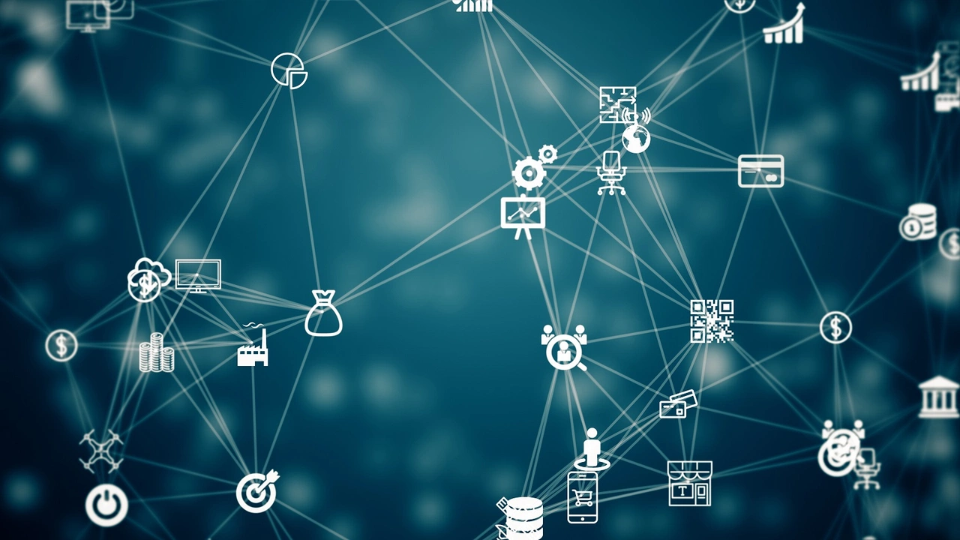
DEEP LEARING-BASED RESOURCE SHEDULING
BY
USING EDGE COMPUTING IOT NETWORKS
Presented by:
Mr. A. Ramesh
M Tech., (PhD)

Slide 2
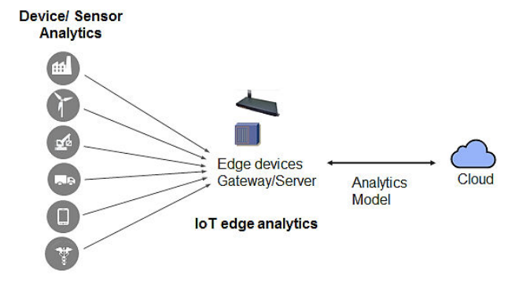
Internet of Things (IoT)
The Internet of Things (IoT) is a network of physical devices that can collect and share data with other devices and systems over the internet.
The Internet of Things (IoT) is expected to improve the quality of human lives through billions of Internet-based devices that connect the physical and digital worlds.

Slide 3
CONTENTS:
Introduction to Cloud Computing
Edge Computing
Limitations of Cloud Computing
Need for Edge Computing
Edge Computing Terms and Definitions
IoT and Edge Computing
Architecture of Edge Computing
Literature review
Challeges
Proposed system
Applications
Conclusion
References

Slide 4
INTRODUCTION TO CLOUD COMPUTING
Cloud Computing is an infrastructure and software system that allows for access to shared network of storage, server and application over the internet.
With Cloud Computing users can access database resources via the internet from anywhere for as long as they need without worrying about any maintenance and management of actual resources.

Slide 5
PROBLEM STATEMENT
The computational requirements of IoT applications are satisfied through edge computing which reduces latency, and energy consumption.
By adopting edge computing in IoT applications, minimum response time and cost benefits are availed by the users.
However, due to multiple service requirements, and networking protocols, the computational complexity increases in the resource scheduling process. Various scheduling algorithms are evolved based on clustering, and classification models. However, conventional methods lag in performance due to high data dimensionality variations that occurred due to the dynamic environment. Deep learning-based resource scheduling models perform better than traditional scheduling processes. However, the overviewed results do not provide enough scheduling information which leads to inappropriate scheduling.

Slide 6
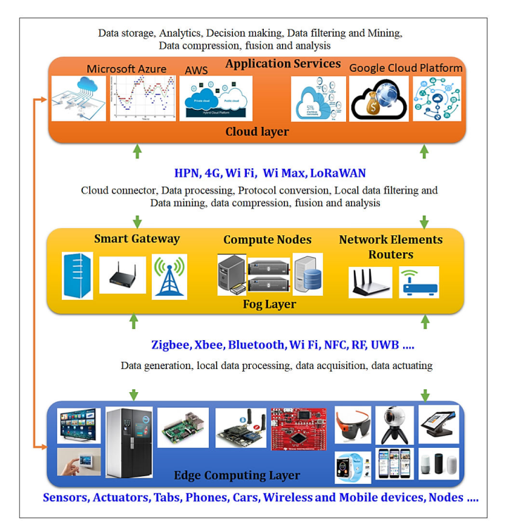
Work Flow of Edge Computing

Slide 7
EDGE COMPUTING
Edge computing is a distributed computing model that brings computation and data storage closer to the sources of data.
Edge computing is a distributed IT architecture which moves computing resources from clouds and data centers as close as possible to the originating source.
The main goal of edge computing is to reduce latency requirements while processing data and saving network costs.

Slide 8
NEED FOR EDGE COMPUTING
Developed due to the exponential growth of IoT devices, which connect to the internet for managing information over cloud.
Creates a flexible scalable and more automated technology, systems and core business process environment.
Optimizes data capture and analysis at the edge to create actionable business intelligence

Slide 9
Literature Review
Different machine learning, deep learning, and optimization models are considered for analysis and the observations are presented to highlight the feature merits and demerits.
Apart from the various befits of IOTcomputation facilities and storage limitation devices must acquire proper resources from edge computing to complete the desired tasks. Inappropriate resources lead to increased computation time and energy consumption which may affect the overall quality of services

Slide 10
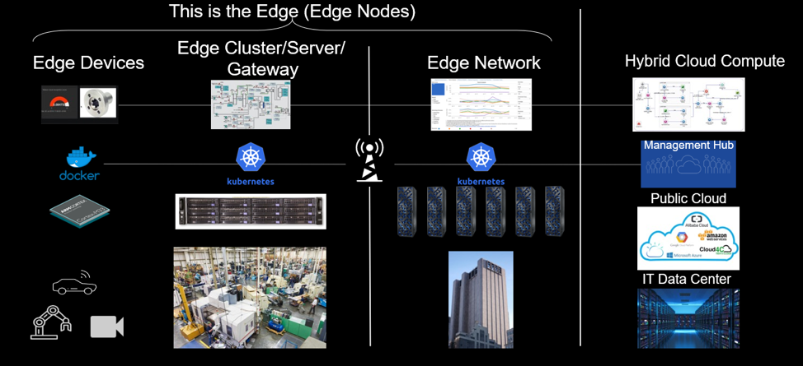
EDGE COMPUTING TERMS AND DEFINITIONS
Edge
Edge device
Edge Gateway
Edge Server
Edge Node
Cloud

Slide 11
INTERNET OF THINGS AND EDGE COMPUTING
The Internet of Things refers to a system of interrelated internet-connected objects that are able to collect and transfer data over a wireless network without human intervention.
The IoT, with the help of edge computing , intelligence moves to the edge.

Slide 12
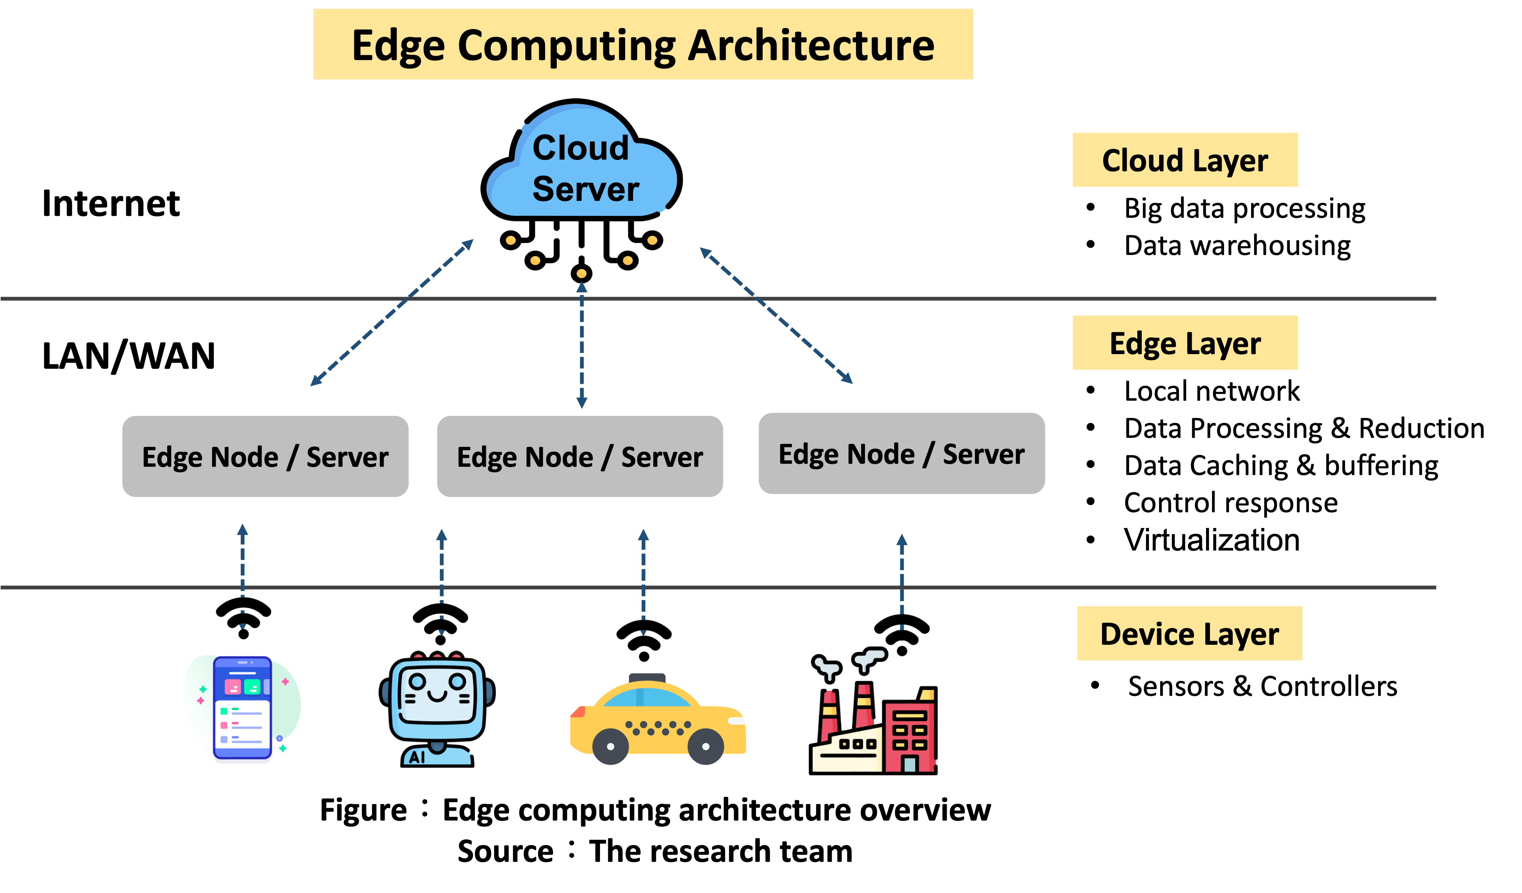
ARCHITECTURE OF EDGE COMPUTING
Edge solutions are usually multi-layered distributed architectures encompassing and balancing the workload between the edge layer, the edge cloud or Edge network and the enterprise layer.

Slide 13
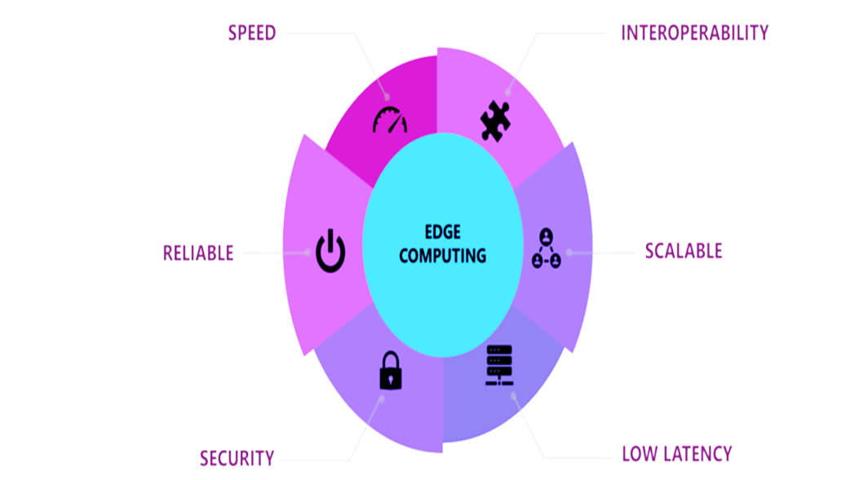
EDGE COMPUTING BENEFITS
Speed
Scalability
Reliability
Security
Cost Effectiveness

Slide 14
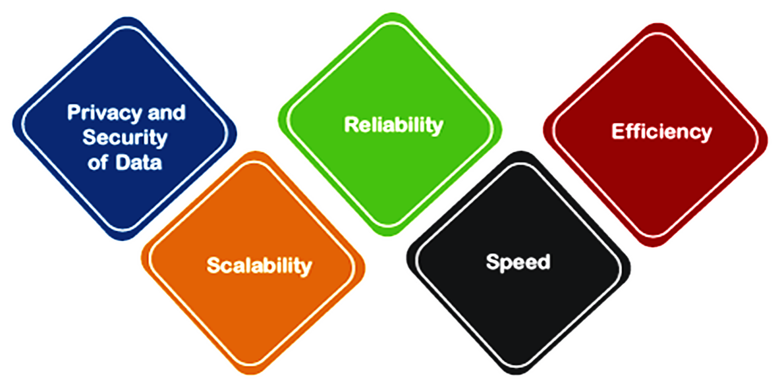
CHALLENGES IN EDGE COMPUTING
Security
Incomplete data
More storage space
Investment cost

Slide 15
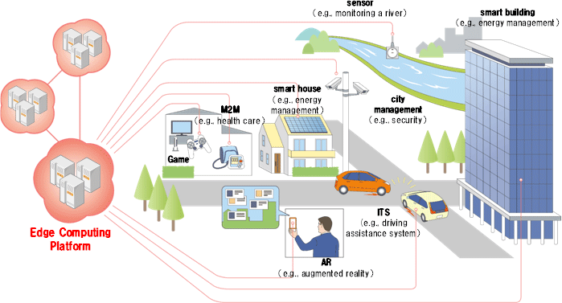
APPLICATIONS
Manufacturing
Farming
Improved Healthcare
Traffic Management
Smart Homes

Slide 16
PROPOSED SYSTEM
The proposed deep learning presented as a two-phase approach which includes clustering in the first phase and resource scheduling in the second phase. Improved spectral clustering is adopted to reduce the data overlapping Long-Short-Term-Memory (LSTM) is incorporated for resource scheduling to enhance resource utilization and reduce latency.

Slide 17

CONCLUSION
Edge computing gained notice with the rise if IoT and the sudden gult of data such devices produce. Bringing computation to the network's edge minimizes the amount of long-distance communication that has to happen between a client and server.

Slide 18
REFERENCES
https://azure.microsoft.com/en-in/resources/cloud-computing-dictionary/what-is-edge computing#:~:text=Edge%20computing%20is%20a%20distributed,the%20edge%20of%20the%20network.
K. Cao, Y. Liu, G. Meng and Q. Sun, "An Overview on Edge Computing Research," in IEEE Access, vol. 8, pp. 85714-85728, 2020, doi: 10.1109/ACCESS.2020.2991734.
https://doi.org/10.1016/j.future.2019.02.050

Slide 19


